Slide 1

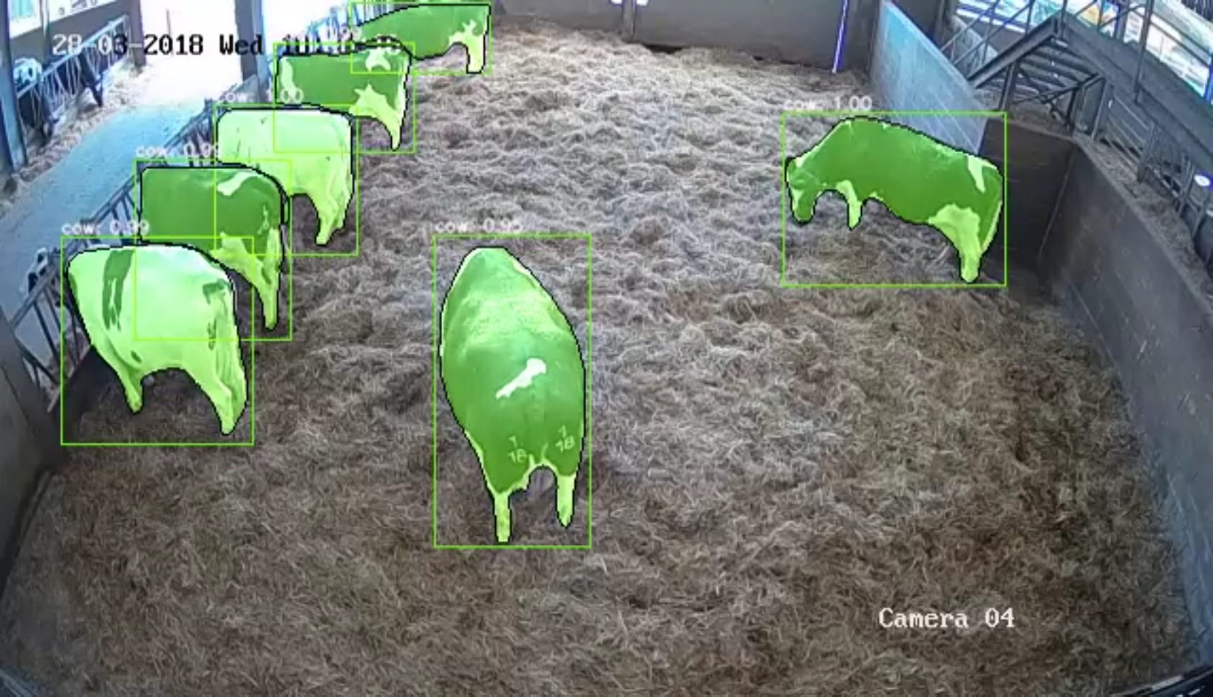
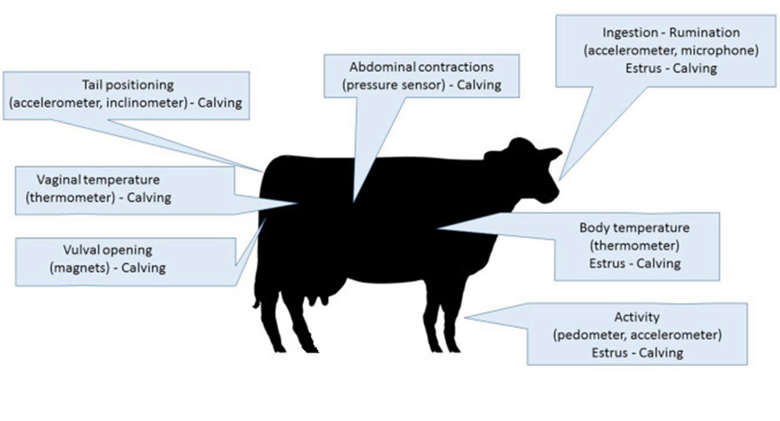
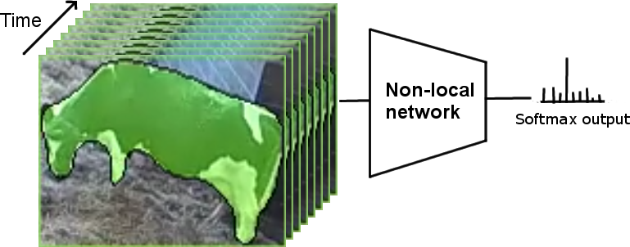
Using image analysis to monitor cow (and calf) fitness’
John McDonagh, Dr Matthew Bell, Dr Yorgos Tzimiropoulous
Introduction
Monitoring of dairy cows and their calf during parturition is essential in determining if there are any associated problems for mother and offspring and whether or not there is a need for human intervention, which can be dangerous for stockperson. Behavioural changes, such as standing or lying bouts, can give an indication to whether there is a need for assistance.
Object detection
Current automated devices
Fig 2. Video surveillance at Sutton Bonington Dairy Centre. Masks are shown in colour, bounding boxes, category and confidence scores are also displayed.
Object detection and instance segmentation (Fig 2) is accomplished using the state-of-the-art Mask R-CNN (He et al. 2017), trained on the MS COCO (Lin et al. 2015) dataset.
We use Resnet-50 (He et al. 2015) as the backbone architecture.
To improve detection in different scales we use a Feature pyramid network (Yin et al. 2017).
Further improvements to detection/segmentation are achieved using a Non-local block (Wang et al. 2018) and group normalisation (Wu and He, 2018).
Fig 1. Types of automated devices that are currently used for monitoring calving
Source: Saint-Diziera and Chastant-Maillard, 2018.
The dairy farming industry currently uses four different types of automated devices for monitoring calving detection (Fig 1) all of which are invasive to the cow
Benefits of using image analysis
Does not need to rely on transponder attachments or invasive tools
Provides more information at a relatively low cost
Uses existing video surveillance
Can detect and track the new born calf
Possible to identify rare behavioural patterns or behaviours
Behaviour Classification
To predict animal behaviour, we use a Non-Local Neural network (Wang et al. 2018) with 9 behaviour categories, (Fig 3).
New behaviour dataset
A new dataset for the purpose of detecting behaviour changes in cows.
46 calving’s are recorded (10 hours before and 5 hours after parturition).
9 categories (Table 1) are annotated
Around 1,000 videos (10 seconds clips) in each category.
Total of 33 hours for training and 2.5 hours for testing/evaluation
Fig 3. Eight evenly spaced frames are passed through the non-local network, a softmax layer is used to predict the behaviour category.
References
He, K., Gkioxari, G., Dollár, P. and Girshick, R. 2017. Mask R-CNN. arXiv:1703.06870v3
He, K., Zhang, X., Shaoqing, R. and Sun, J. 2015 Deep Residual Learning for Image Recognition. arXiv:1512.03385v1
Lin, T.Y., Dollár, P., Girshick, R., He, K., Hariharan, B. and Belongie, S. 2017. Feature Pyramid Networks for Object Detection. arXiv:1612.03144v2
Lin, T.Y., Maire, M., Belongie, S., Hays, J., Perona, P., Ramanan, D., Dollár, P. and Zitnick, C. 2014. Microsoft COCO: Common objects in context. arXiv:1405.0312v3
Saint-Diziera and Chastant-Maillard. 2018, ‘Potential of connected devices to optimize cattle reproduction’, Theriogenology, Vol. 112, pp.53-62.
Wang, X., Girshick, R., Gupta, A. and He, K. 2018. Non-local Neural Networks. arXiv:1711.07971v3
Wu, Y. and He, K. 2018. Group Normalization arXiv:1803.08494v3
State 1 (Posture) | State 2 (Behaviour) | Events (Behaviour) | Events (Parturition)
Stand | Eating | Contractions (lying/standing) | Birth
Lie | Drinking
Walk
Shuffle
Table 1. Behavioural state and events to be recorded around parturition for each cow.

