Slide 1



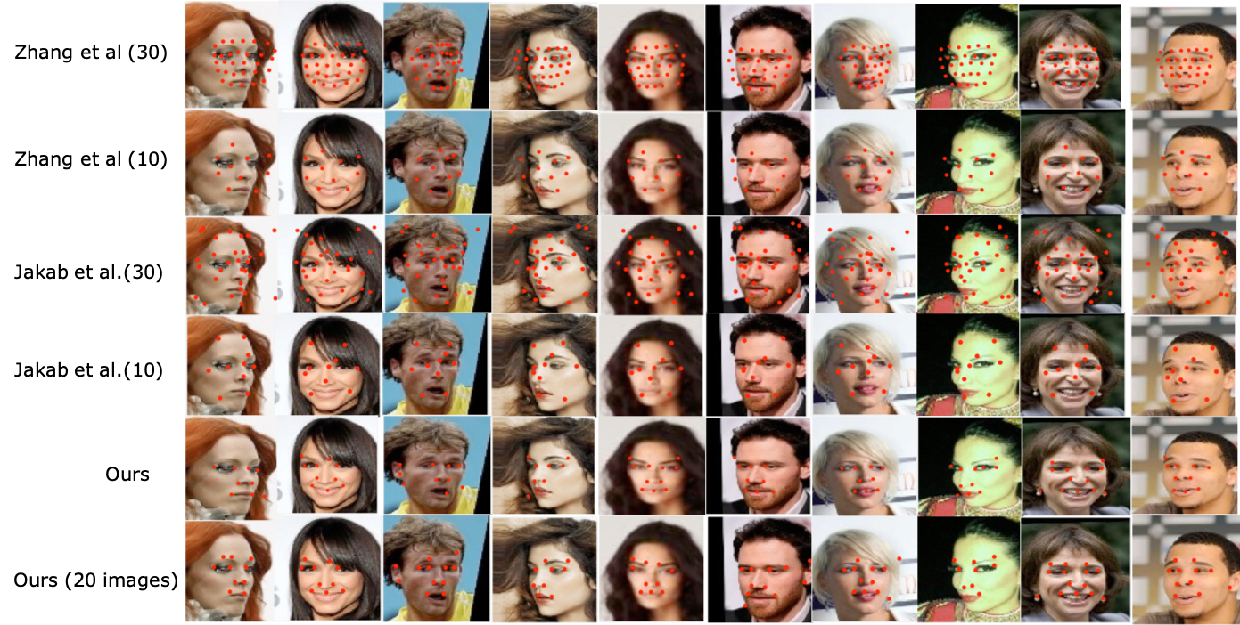
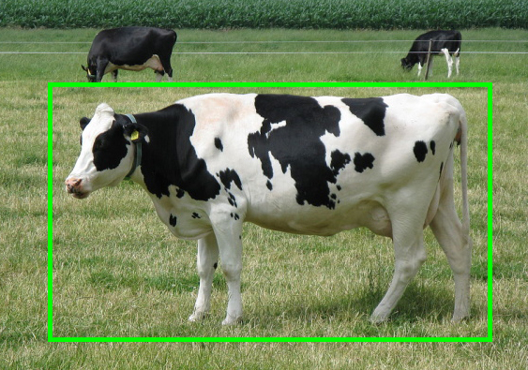
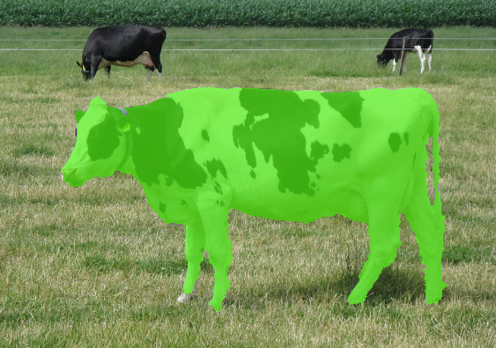
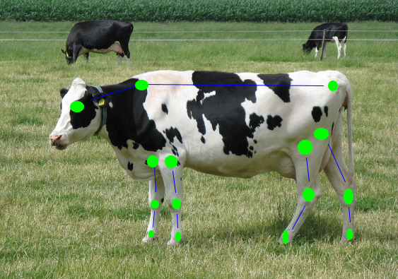

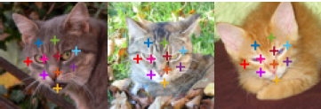
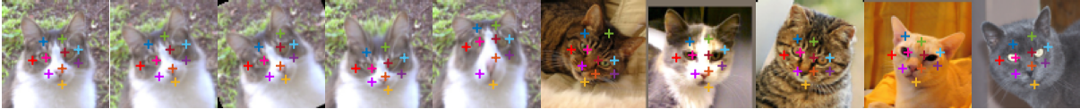
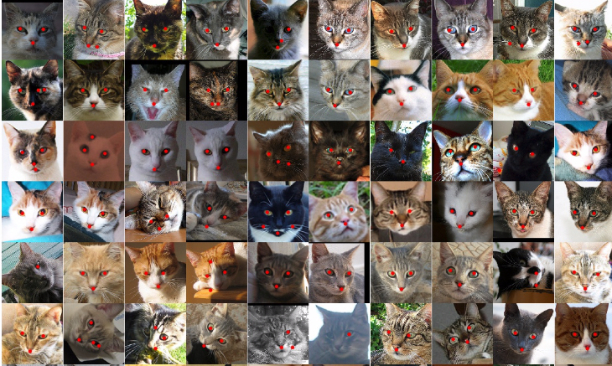
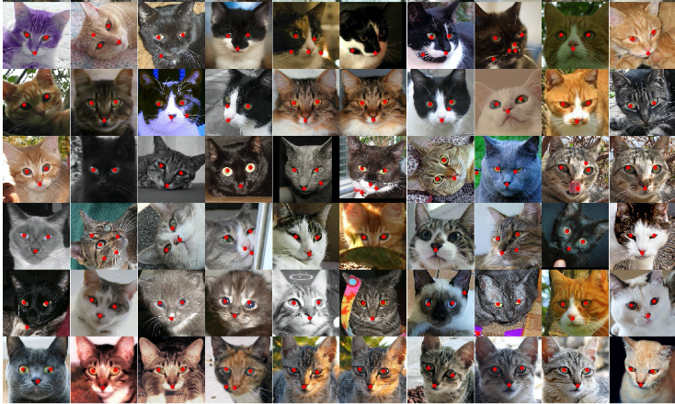
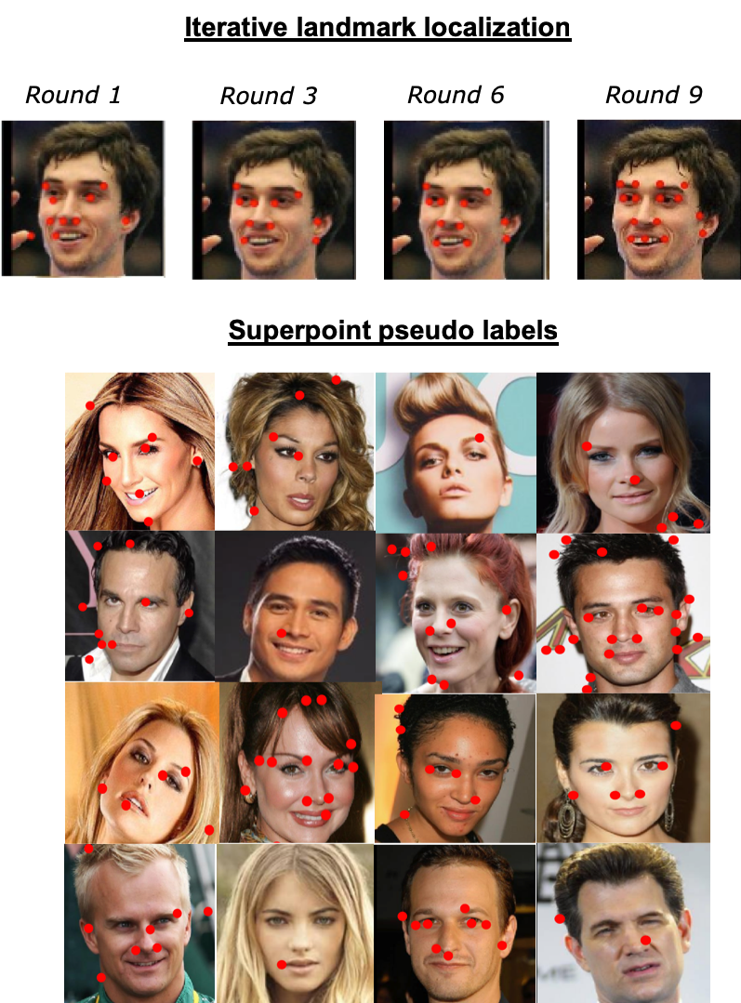
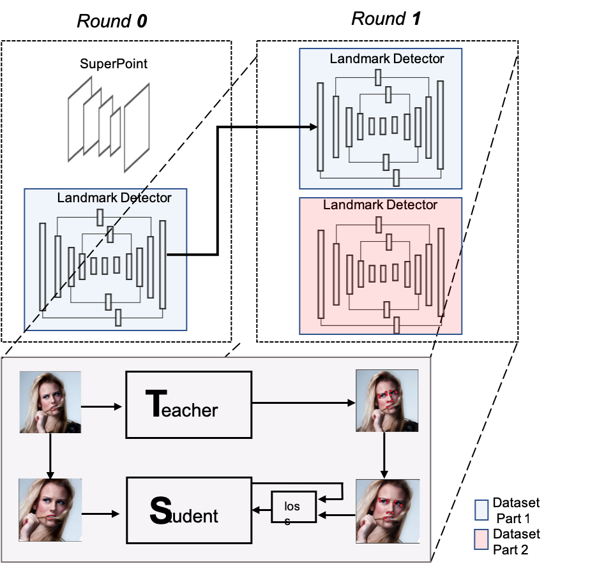

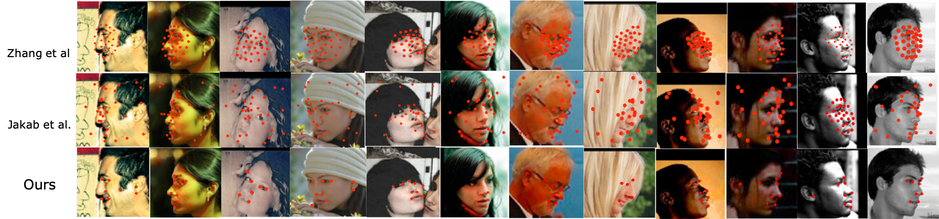
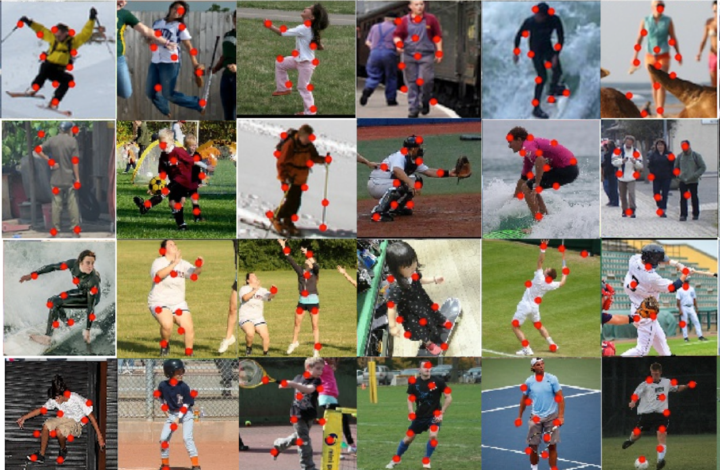
Landmark Localisation:
A new approach for Animal Monitoring
Dimitris Mallis, Dr Matt Bell, Dr Yorgos Tzimiropoulos
Motivation
Landmark localization can be used for accurate animal monitoring
Can solve several monitoring problems in a unified pipeline
Multiple advantages over current monitoring approaches (non intrusive, cheaper, accurate)
Applications
Continuous accurate tracking of multiple animals
Calving management
Behavior detection
Locomotion and lameness detection
Visual Comparison with State-of-the-art on faces:
Landmarks
Our Approach
Learns to detect object landmarks using deep neural networks
Does not require expensive annotations
Can reliably detect object landmarks in a variety of datasets
Examines learning under extreme label noise for localization tasks
Visual Comparison with State-of-the-art on cat faces:
Conclusions
Our method can detect meaningful landmarks without need for manual annotations
Preliminary results show it can perform better that other recently proposed methods
Can be used without modification over multiple datasets
Visual Comparison with State-of-the-art over extreme poses:
Visual Results on human body:

